Slide 1
HTML

Slide 2
What is HTML?
HTML is a markup language for describing web documents (web pages).
HTML stands for Hyper Text Markup Language
A markup language is a set of markup tags
HTML documents are described by HTML tags
Each HTML tag describes different document content

Slide 3
HTML Tags <tagname>content</tagname>
<!DOCTYPE html> <html> <head> <title>Page Title</title> </head> <body> <h1>My First Heading</h1> <p>My first paragraph.</p> </body> </html>
The DOCTYPE declaration defines the document type to be HTML
The text between <html> and </html> describes an HTML document
The text between <head> and </head> provides information about the document
The text between <title> and </title> provides a title for the document
The text between <body> and </body> describes the visible page content
The text between <h1> and </h1> describes a heading
The text between <p> and </p> describes a paragraph

Slide 4
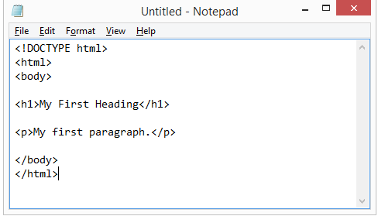
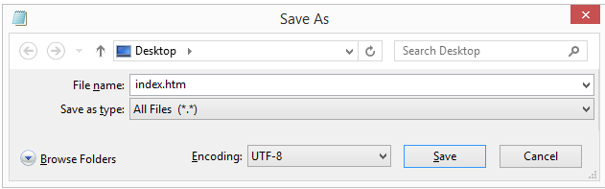
HTML Editors
Write HTML Using Notepad or TextEdit

Slide 5
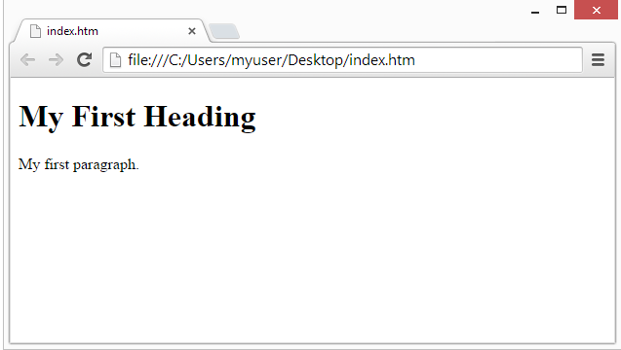
Run HTML Programs
Open the saved HTML file in your favourite browser. The result will look much like this:

Slide 6
HTML Basics
HTML Links
<a href="http://www.w3schools.com">This is a link</a>
HTML Images
<img src="w3schools.jpg" alt="W3Schools.com" width="104" height="142">
HTML Background Color
<body style="background-color:lightgrey;">
HTML Text Color
<h1 style="color:blue;">This is a heading</h1> <p style="color:red;">This is a paragraph.</p>
HTML Fonts
<h1 style="font-family:verdana;">This is a heading</h1> <p style="font-family:courier;">This is a paragraph.</p>

Slide 7
HTML Basics
HTML Text Size
<h1 style="font-size:300%;">This is a heading</h1> <p style="font-size:160%;">This is a paragraph.</p>
HTML Text Alignment
<h1 style="text-align:center;">Centered Heading</h1> <p>This is a paragraph.</p>

Slide 8
HTML Text Formatting Elements
<p><b>This text is bold</b>.</p>
Tag | Description
<b> | Defines bold text
<em> | Defines emphasized text
<i> | Defines italic text
<small> | Defines smaller text
<strong> | Defines important text
<sub> | Defines subscripted text
<sup> | Defines superscripted text
<ins> | Defines inserted text
<del> | Defines deleted text
<mark> | Defines marked/highlighted text

Slide 9

HTML Table Example
<table > <tr> <td>Jill</td> <td>Smith</td> <td>50</td> </tr> <tr> <td>Eve</td> <td>Jackson</td> <td>94</td> </tr> </table>

Slide 10

HTML Table Example
<table border="1" > <tr> <td>Jill</td> <td>Smith</td> <td>50</td> </tr> <tr> <td>Eve</td> <td>Jackson</td> <td>94</td> </tr> </table>

Slide 11
HTML Table Example
<table border="1" > <tr> <td>Jill</td> <td>Smith</td> <td>50</td> </tr> <tr> <td>Eve</td> <td>Jackson</td> <td>94</td> </tr> </table>

Slide 12
Table With Heading
<table >
<tr>
<th>Firstname</th>
<th>Lastname</th>
<th>Points</th>
</tr>
<tr>
<td>Jill</td>
<td>Smith</td>
<td>50</td>
</tr>
<tr>
<td>Eve</td>
<td>Jackson</td>
<td>94</td>
</tr>
<tr>
<td>John</td>
<td>Doe</td>
<td>80</td>
</tr>
</table>
</body>
</html>

Slide 13
HTML Forms
The <form> Element
HTML forms are used to collect user input.
The <form> element defines an HTML form:
HTML forms contain form elements.
Form elements are different types of input elements, checkboxes, radio buttons, submit buttons, and more.

Slide 14
HTML Form Elements
Tag | Description
<form> | Defines an HTML form for user input
<input> | Defines an input control
<textarea> | Defines a multiline input control (text area)
<label> | Defines a label for an <input> element
<fieldset> | Groups related elements in a form
<legend> | Defines a caption for a <fieldset> element
<select> | Defines a drop-down list
<optgroup> | Defines a group of related options in a drop-down list
<option> | Defines an option in a drop-down list
<button> | Defines a clickable button
<datalist> | Specifies a list of pre-defined options for input controls
<output> | Defines the result of a calculation

Slide 15


HTML Form Elements
Text Input
<form> First name:<br> <input type="text" name="firstname"><br> Last name:<br> <input type="text" name="lastname"> </form>
Radio Button Input
<form> <input type="radio" name="gender" value="male" checked> Male<br> <input type="radio" name="gender" value="female"> Female<br> <input type="radio" name="gender" value="other"> Other </form>

Slide 16
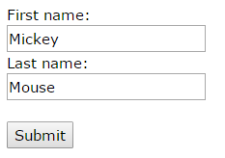
HTML Form Elements
The Submit Button
<form action="action_page.php"> First name:<br> <input type="text" name="firstname" value="Mickey"><br> Last name:<br> <input type="text" name="lastname" value="Mouse"><br><br> <input type="submit" value="Submit"> </form>
The Action Attribute
The action attribute defines the action to be performed when the form is submitted.
The common way to submit a form to a server, is by using a submit button.
Normally, the form is submitted to a web page on a web server.
<form action="action_page.php" method="get">

Slide 17
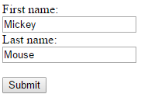
HTML Form Elements
The Name Attribute
<form action="action_page.php"> First name:<br> <input type="text" value="Mickey"><br> Last name:<br> <input type="text" name="lastname" value="Mouse"><br><br> <input type="submit" value="Submit"> </form>

Slide 18
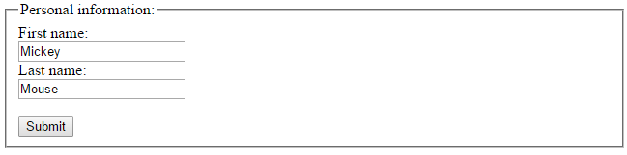
HTML Form Elements
Grouping Form Data with <fieldset>
<form action="action_page.php"> <fieldset> <legend>Personal information:</legend> First name:<br> <input type="text" name="firstname" value="Mickey"><br> Last name:<br> <input type="text" name="lastname" value="Mouse"><br><br> <input type="submit" value="Submit"> </fieldset> </form>

Slide 19


HTML Form Elements
The <select> Element (Drop-Down List)
<select name="cars"> <option value="volvo">Volvo</option> <option value="saab">Saab</option> <option value="fiat">Fiat</option> <option value="audi">Audi</option> </select>

Slide 20
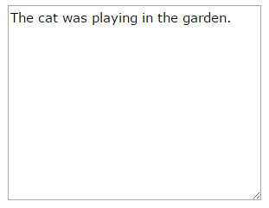
HTML Form Elements
The <textarea> Element
<textarea name="message" rows="10" cols="30"> The cat was playing in the garden. </textarea>

Slide 21
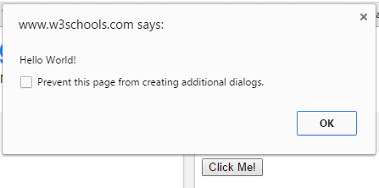
HTML Form Elements
The <button> Element
<button type="button" onclick="alert('Hello World!')">Click Me!</button>

Slide 22
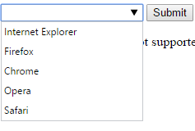
HTML Form Elements
HTML 5 <datalist>
<form action="action_page.php">
<input list="browsers" name="browser">
<datalist id="browsers">
<option value="Internet Explorer">
<option value="Firefox">
<option value="Chrome">
<option value="Opera">
<option value="Safari">
</datalist>
<input type="submit">
</form>

Slide 23


HTML Form Elements
HTML5 <output> Element
<form action="action_page.asp" oninput="x.value=parseInt(a.value)+parseInt(b.value)"> 0 <input type="range" id="a" name="a" value="50"> 100 + <input type="number" id="b" name="b" value="50"> = <output name="x" for="a b"></output> <br><br> <input type="submit"> </form>

